Slide 1
C.K. Pithawalla College of Commerce-Management-Computer
Application
Project Title: Habit Tracker
GUIDE:
Mr. Dipan Naik
SUBMITED BY:
Yash Jariwala (211)
Pratham Hathiwala (210)

Slide 2
Project Profile
Project Title: Habit Tracker
Project Type: Android Mobile Application
Project Objective: a mobile app for creating and maintaining long-term positive habits
Project Guide:
Team Member:
Mr. Dipan Naik 2
Front-End: Kotlin
Back-End: SQLite
Submitted By: Yash Jariwala, Pratham Hathiwala

Slide 3
Project Introduction
Habit Tracker is a powerful, minimalistic, and user- friendly Android application designed to help users build and maintain positive habits.
Lightweight and optimized performance
Reminders Customizable notifications for each habit
Privacy-focused design with offline functionality
Flexible scheduling options
Data Control and Export to CSV (spreadsheets) and SQLite database

Slide 4
Environmental Description
Client Side:
Android smartphone with compatible version
Minimum storage requirements
Development Side:
Processor (i31220p)
OS (Windows 11)
RAM (8 GB)
Storage (512 GB SSD)

Slide 5
Tools & Technology
Documentation Tools
MS Word
Development Tools
Android Studio
Technology
o Core Technology:
Kotlin
JSON
o Extra Technology:
Any additional libraries used

Slide 6
Existing System
Traditional Habit Tracking Methods: Includes paper- based systems like bullet journals, wall calendars, and habit tracking sheets.
Limitations: Lack portability, easily forgotten, no automated reminders.
Data Export Difficulty: Difficulty in exporting data for personal analysis.
Privacy Concerns: Often require account creation and internet connection; privacy concerns with data storage on external servers.
Limited Visualization: Limited visualization options.

Slide 7
Proposed System
Aim & objectives
Maintains the concise, direct style you requested.
Focuses on the core aims and benefits of the Habit Tracker app.
Highlights key aspects such as user-
friendliness, privacy, flexibility, and the open- source nature of the project.
Emphasizes the ultimate goal of helping users
improve their lives through better habit tracking and formation.
Expected Advantages
Enhanced Habit Formation: The app's flexible scheduling and advanced habit strength calculation help users build and maintain habits more effectively.
Increased Motivation: Detailed analytics and progress visualization keep users motivated and engaged in their habit-forming journey.

Slide 8
Better Time Management: Customizable reminders and home screen widgets allow users to integrate habit tracking seamlessly into their daily routines.
Data Insights: Easy data export options enable users to perform deeper analysis of their habit data, leading to better self-understanding and improvement strategies.
Resource Efficiency: Optimized for performance, the app works smoothly even on
older devices, making it accessible to a wide range of users.

Slide 9
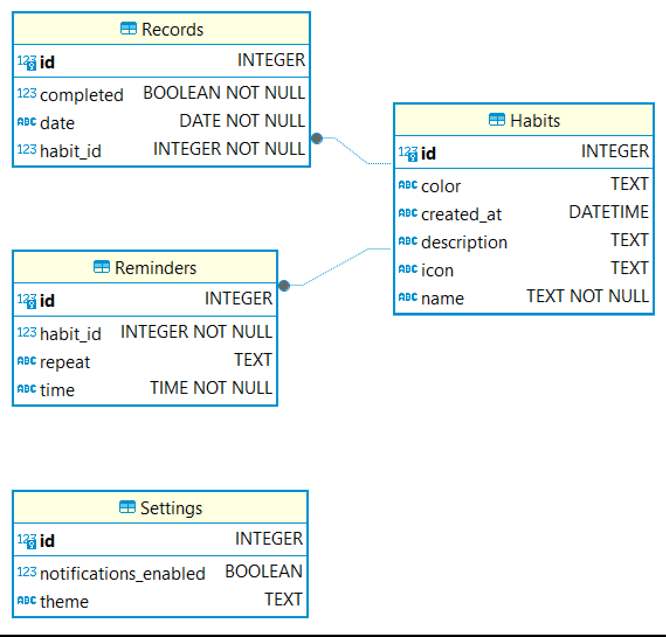
ER Diagram

